Slide 1
PHYSICAL DIAGNOSITC
Memory
CAN message
DID range check
PID Test
CPID Test
DPID Test
DAC SI to Bus Message
How to read DIAG spec
Jul-16-2019
Ngoc Dao

Slide 2
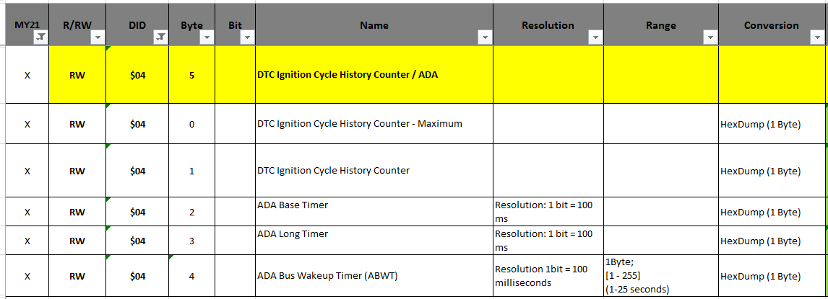
Memory (1/4)
I. DID (Data Identifier)
TCP / VCP setting data
Timer, Counter, Function enable / disable ETC
Compare value, range(Read & Write) with ALDL Spec
Default Value Check target memory

Slide 3
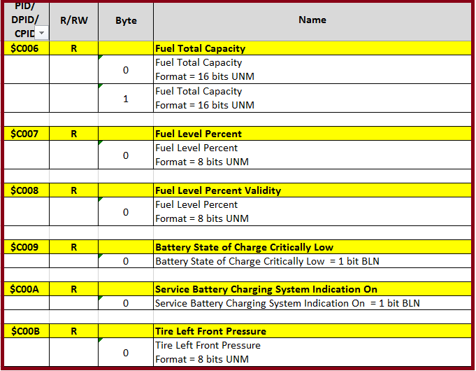
Memory (2/4)
II. PID (Parameter Identifier)
Stored vehicle state from vehicle message
Battery state, Fuel info, Tire state......

Slide 4
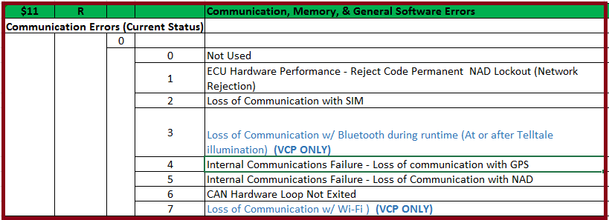
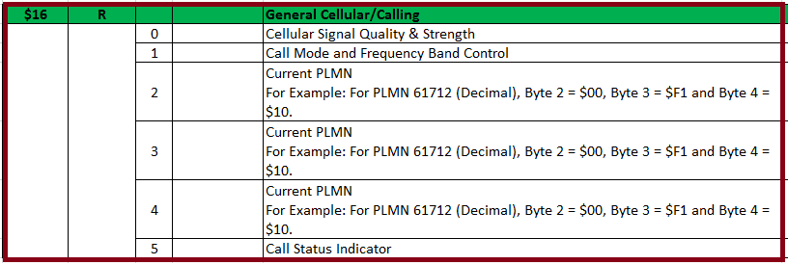
Memory (3/4)
III. DPID (Data Packet Identifier)
Trouble info
Network status

Slide 5
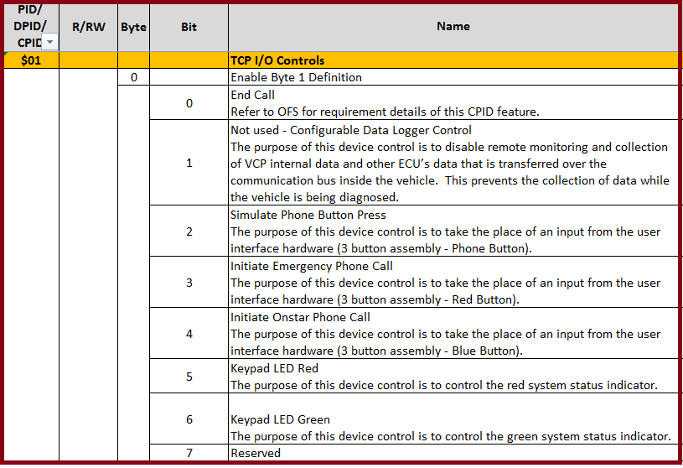
Memory (4/4)
VI. CPID (Control Packet Identifier)
Memory for Device Control
Key pad, Call end, ECU reset, Disable Output…

Slide 6
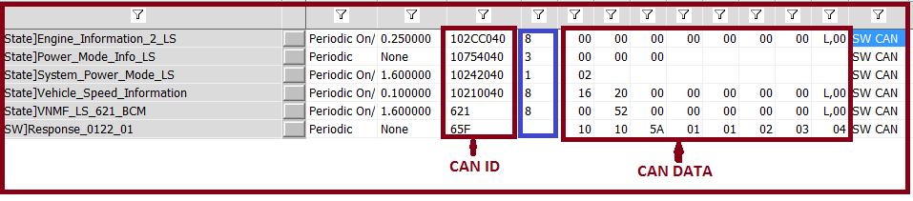
CAN message (1/8)
CAN message includes: CAN ID (11 bits/29 bits) + Data
Hecxa number
Length: max 08 bytes
Channel: HS/LS
Send One or Periodic

Slide 7
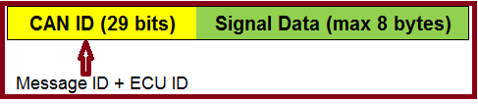
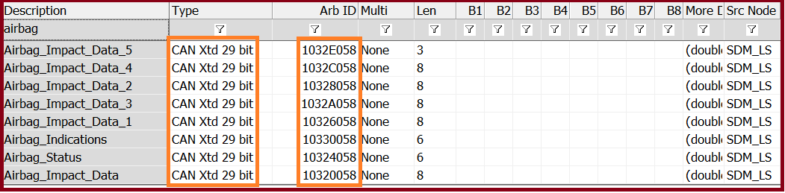
CAN message (2/8)
II. CAN message types (1)
Signal message
Include information of vehicle state or events
Signal message data is stored in PID memory
No response message
Structure:
- Example:

Slide 8
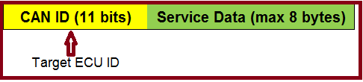
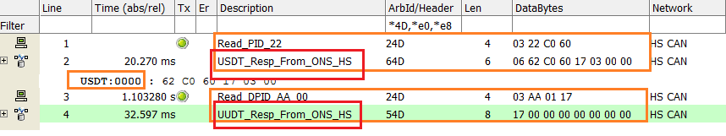
CAN message (3/8)
III. CAN message types (2)
2. Service message
Message for Diagnostic Services
Request and Response message is always in paired
Structure:
- Example:
Notes:
$2xx = physical request CAN Identifier
$5xx = UUDT response CAN Identifier
$6xx = USDT response CAN Identifier

Slide 9
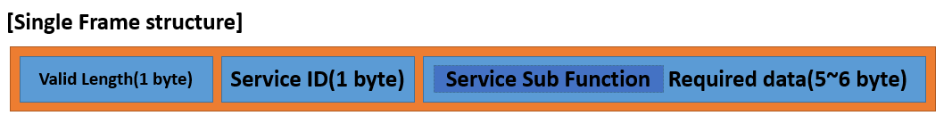
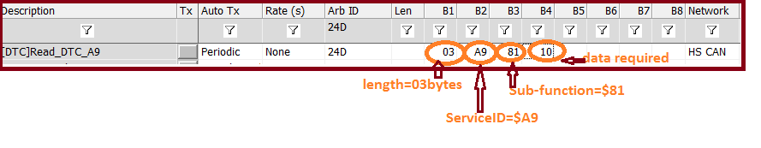
CAN message (4/8)
IV. Single Frame
Example
Notes:
Valid Length : Defines a valid length in the frame
Service ID : Service ID for request
Sub Function : Sub Function ID – optional
Required data : Data service detail

Slide 10
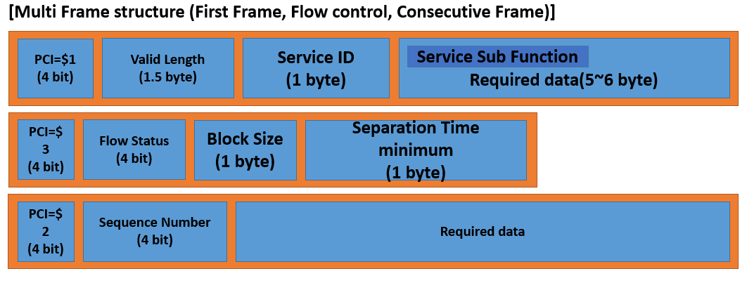
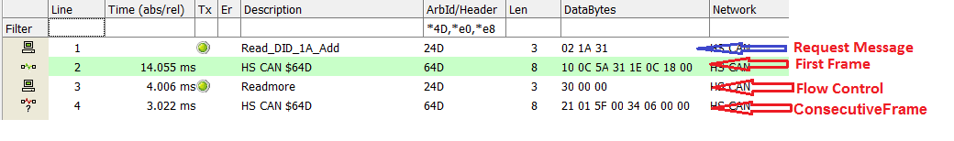
CAN message (5/8)
V. Multiple Frame
Example
Notes:
Flow Status : Status information on the receiving side
Block Size : Number of frames to receive after flow control
ST min : Interval of frames to receive after flow control
Sequence Number : Response frame number
PCI: Protocol Control Information

Slide 11
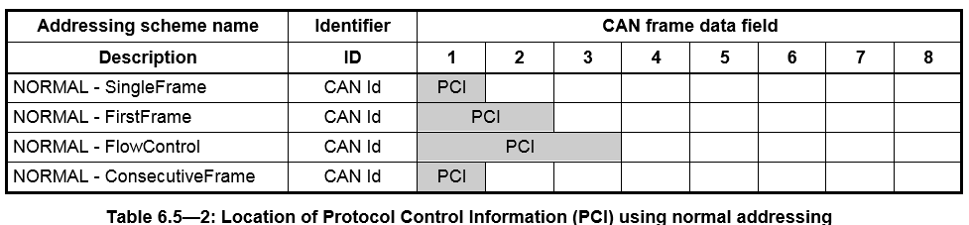
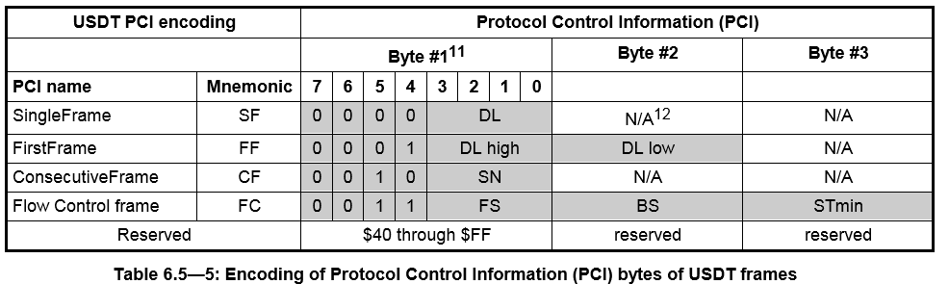
CAN message (6/8)
VI. Protocol Control Information (PCI) formats for GMLAN

Slide 12
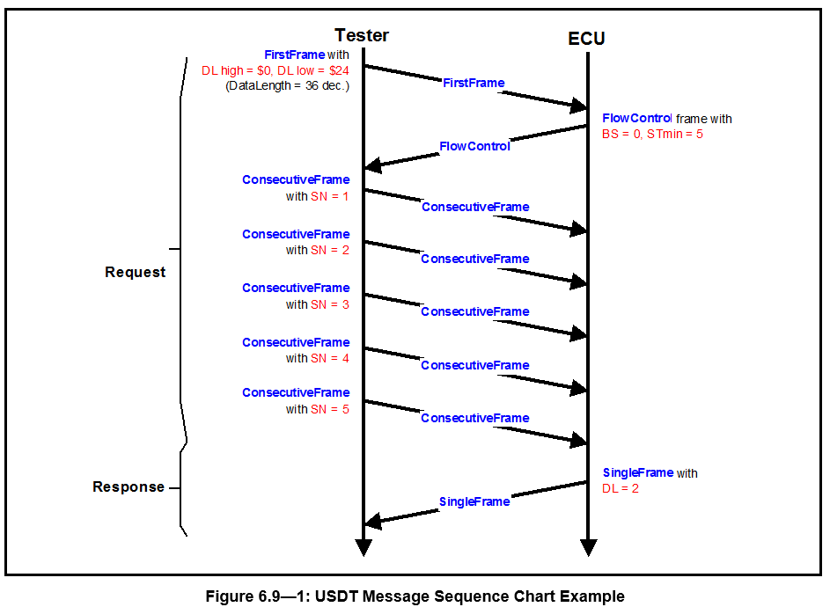
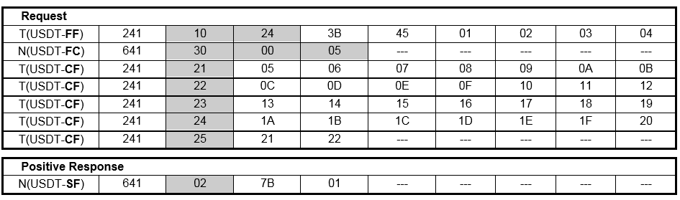
CAN message (7/8)
VII. General USDT Request/Response Sequence Examples

Slide 13
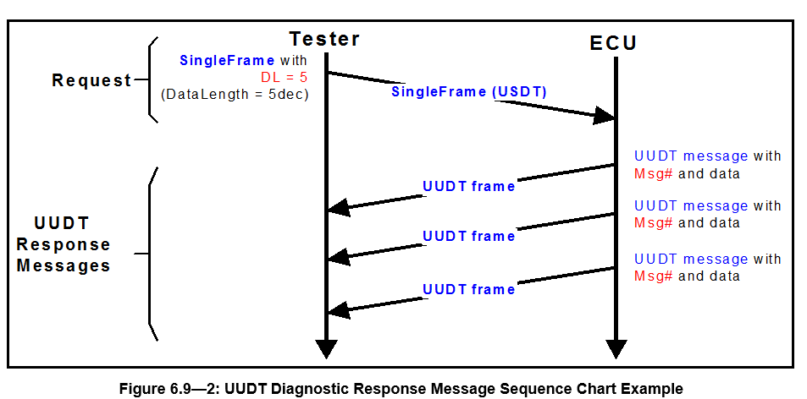
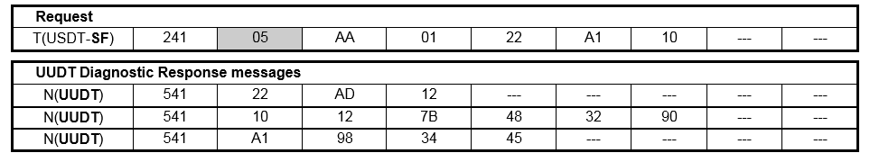
CAN message (8/8)
VIII. General UUDT Request/Response Sequence Examples

Slide 14
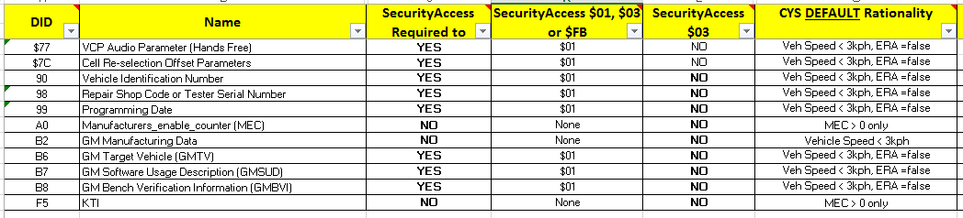
DID Range Check (1/2)
Need to check:
DID A0 (MEC) = $00 or not (use ATT tool)
If A0=$00 > need to re-flashing TCP
DID is ReadWrite/Write or Read only (Refer ALDL spec)
If DID is read only then write >> Response: 03 7F 3B 31
Restriction: Refer CG379
Security Unlock
Speed limitation
Engine condition

Slide 15
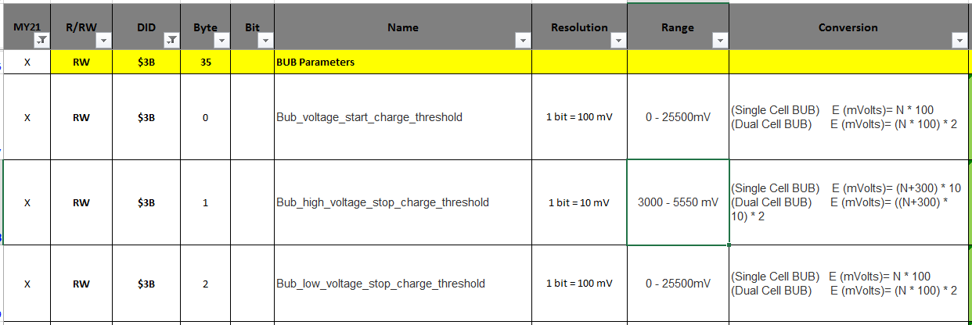
DID Range Check (2/2)
To test:
Send 24D 01 3E (to maintain Diagnostic service)
Send 24D 02 27 01 (to unlock security)
Send Speed < 3kph
If speed >= 3kph: Response: 03 7F 3B 22
Send Engine state = OFF
If Engine = Running: Response: 03 7F 3B 22
Send 24D 03 1A xx (xx is available DID) to read DID’s value
Calculate Valid data range based on ALDL spec
Send message to Write DID

Slide 16
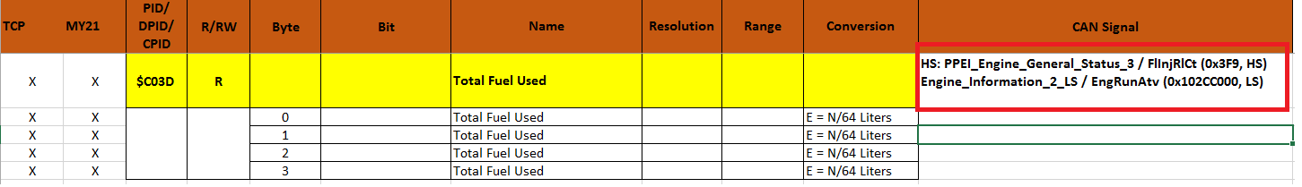
PID Test (1/2)
Vehicle Information is stored in PID memory. So to check PID value, we need to simulate signal which change PID’s data
Check ALDL spec to specify which CAN signal need to send
PID C03D:
Set Maximum of Rolling count: DID$67: byte3.4
Rolling Count signal: $3F9 00 xx xx 00 00 00 00 00 (HS, Oneshot)
Counter and Rolling Count Reset: $3F9 80 00 00 00 00 00 00 00 00 (HS, Oneshot)
To save to PID we need send two signals of Rolling Count, we call are Old and New
Case1: Old < new and new – old < 2000: Data will not be saved to PID until IGN OFF + Door Open
Case2: Old <new and new – old > = 2000: PID = Original + (new – old)/200
Case3: Old > new: PID = Original + ((FFFF – old) + new)/200
Note: the remainder will be saved to memory and will be added to next calculation

Slide 17
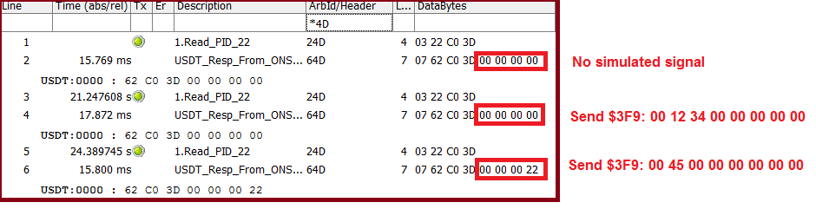
PID Test (2/2)
C03D data is not changed when one of these conditions as below
Engine OFF
Send one signal
Send two same signals
Send 2 different signals but its delta < 2000 and mode is not DRx
Example: C03D=$3E (Original)
Send 00 00 then 00 50 > C03D=?
Send 40 50 > C03D=?
Send 80 00 > C03D=?
Send 12 00 > C03D=?

Slide 18
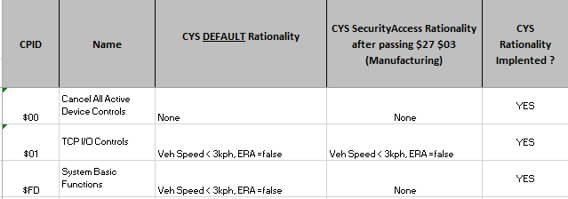
CPID Test (1/1)
CPID is Write only DID (Cannot read its values)
CPID $00: Cancel All Active Device Control
CPID $01: TCP I/O Controls
Terminated normal call (Cannot terminate Collision, OCC initiated or Emergency call)
3BA press
Control Telltale status
CPID $FD: System Basic Functions
Disable all system output ($FD $80): All messages from the VCP/TCP ($97) will freeze for 5s or if cannot stop, it must be maintain data.
Example: NCA message has no data, so it may be still running
ECU reset (VCP/TCP soft reset) ($FD $40)
Reset Source ID: Clear DTC from source ID (during this time VCP/TCP will not check DTC U-code – 5s impact)
If environment is not in Restrictions, it shall send a negative response ($7F $E3 $XX $XX – Device Control Limits Exceeded)
Bug: TCPXI-34178

Slide 19
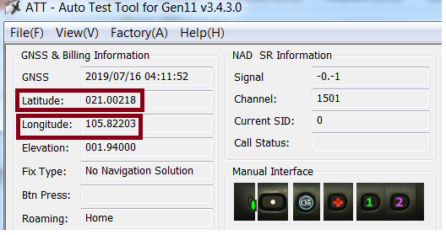


DPID Test (1/3)
Need to know how to setup some DTC – refer to
1. DPID $11: Communication, Memory, & General Software Errors
Check Current Status and History of Communication Errors (Loss of communication with GPS/NAD), Memory Errors (RAM Test Failed, Flash check sum..), General Software Errors (GPS reset, NAD reset…)…
2. DPID $12: Audio, BUB, & Keypad
Check Audio, BUB, & Keypad and Watch dog Time Stamp status
Ignition OFF/ON will reset all bit of DPID$12
Bug: TCPXI-34942
3. DPID $14, $15: GPS Latitude/Longtitude & PDOP

Slide 20
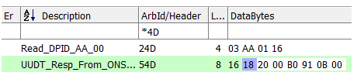
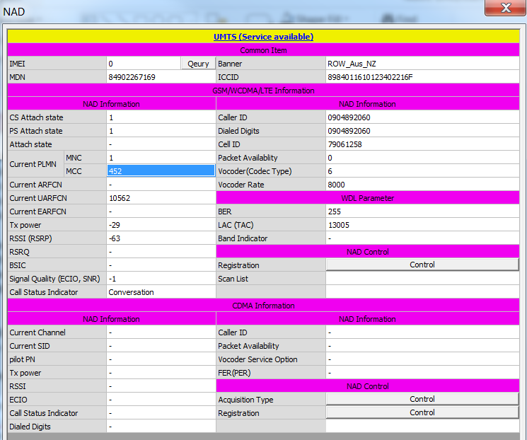
DPID Test (2/3)
4. DPID $16: General Cellular/Calling
Check Check signal strength, Call Mode and Free Band control, current PLMN (MCC & MNC), Call status Indicator
Notes:
PLMN (Public Land Mobile Network):

Slide 21
DPID Test (3/3)
6. DPID $17: Bluetooth
Check DTC B101D-37: Reset Case Type: MDM reset by MDM SW Watchdog/CPU Watchdog/MICOM external, MICOM reset by MICOM HW WatchdogWatchdog
Check Communicaton Errors 2, BUB/Audio Errors (Current Status/History)
Notes:
PLMN (Public Land Mobile Network):

Slide 22
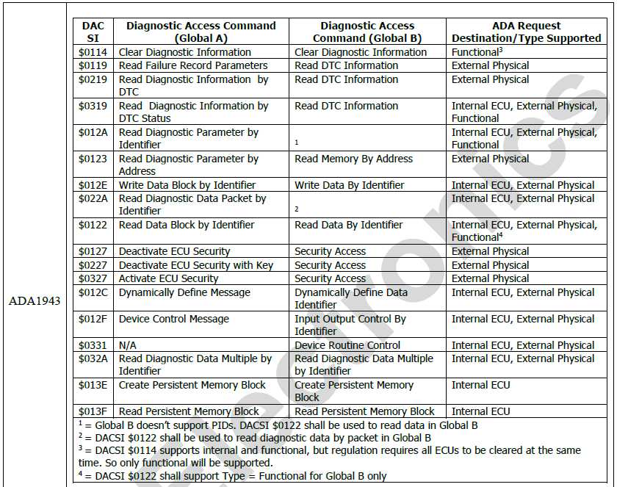
DAC SI (1/2)
DACs Supported for GM Vehicles Table

Slide 23
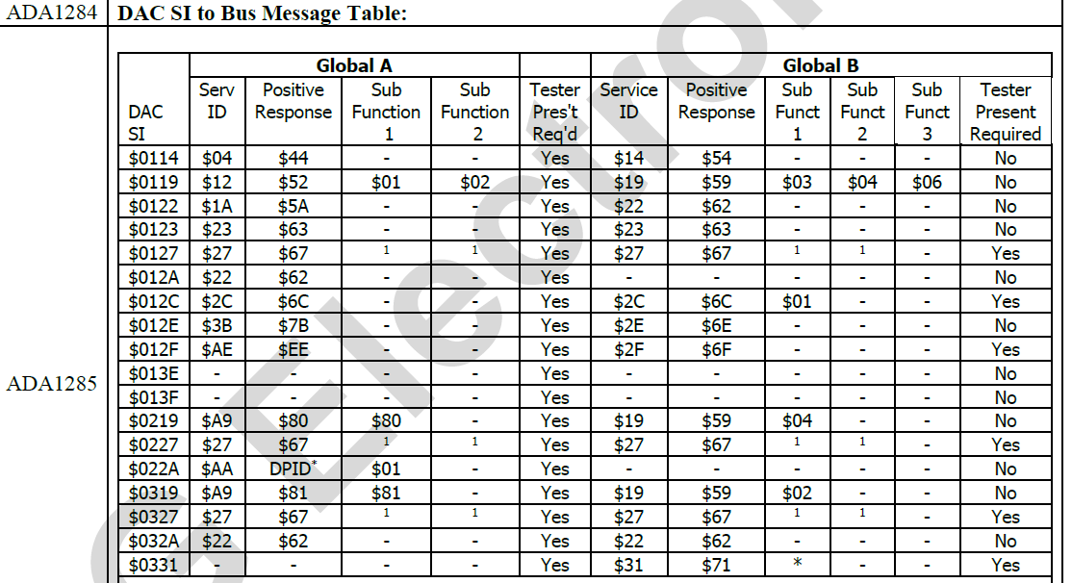
DAC SI (2/2)
DAC SI to Bus Message Table

Slide 24
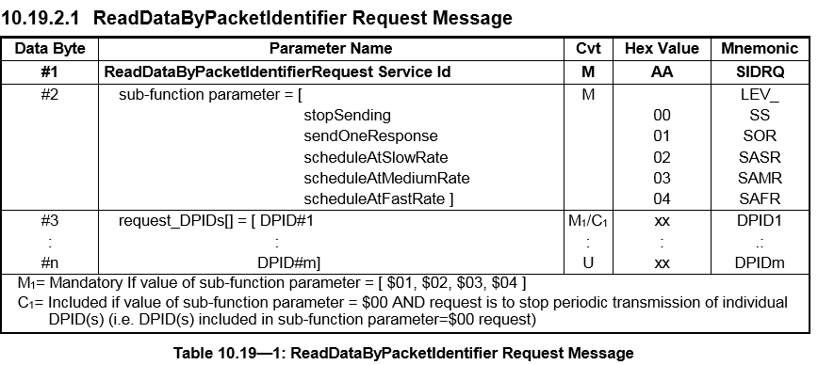
How to read Diagnostic spec (1/2)
Request Message Definition

Slide 25
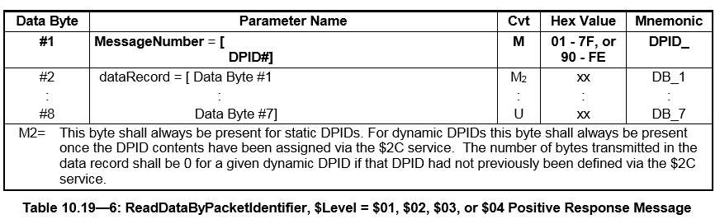
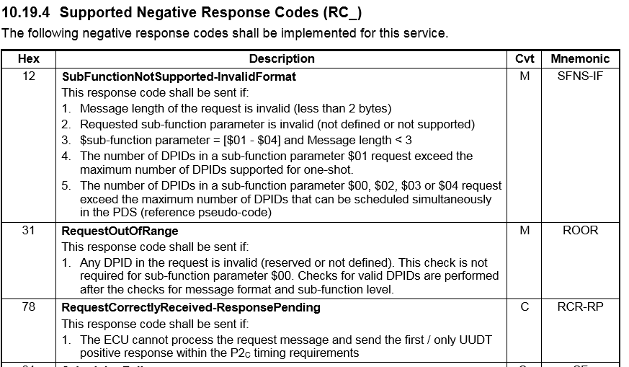
How to read Diagnostic spec (2/2)
Positive Response Message Definition
Supported Negative Response Codes (RC_)

Slide 26
References
GMW3110_V1.5
GIS-745 Abstract Diagnostic Access Revision 1.1 MY20 (Feb 2nd) – LGE
GEN11 GA TCP ALDL_MY21_v4.x Production-4-17-2019
CG379A
DIAG_vi2.nguyen_khanhly.nguyen
PD-TCExecution/vi2.nguyen

Slide 27


